Slide 1
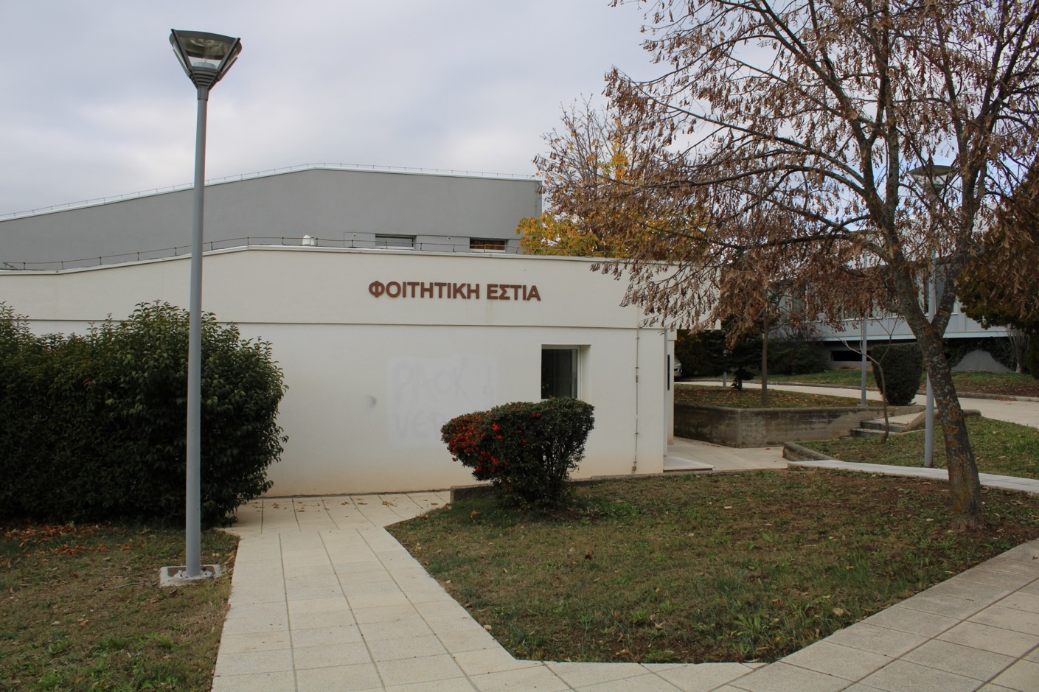
Smart Living Lab at UoWM
Student Dormitories Building – Kozani

Slide 2
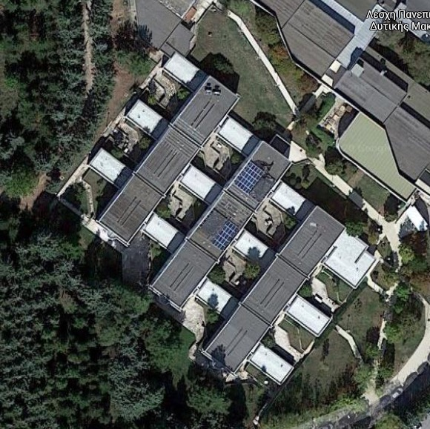
Building Characteristics
Structured area: 4212 m²
Ceiling / floor surface: 2430 m²
Floors: 1 or 2, depending on the space
Openings: 800 m²
The entity has 190 single rooms
The building has undergone insulation improvement, including the addition of insulation for the major part of the roof and walls, while the openings are double glazed ones.
Heating is provided by an oil boiler / conventional terminal units (radiator ones), while the same applies to the Domestic Hot Water (central boiler of the campus).
Cooling units are not present.
Fluorescent lamps are used.

Slide 3
History
PV-Estia
MOST
3. Berlin
4. Regional Excellence
Developed, expanded and certified under various projects, starting at 2017

Slide 4
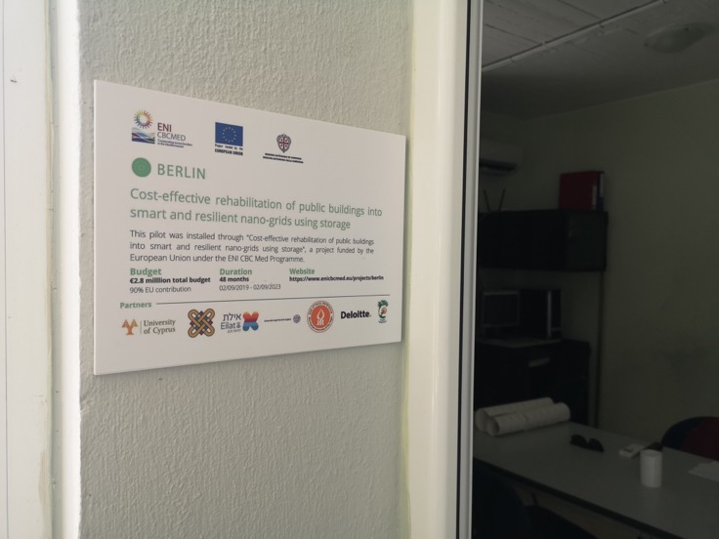
History and Rationale
Developed and expanded under various projects, starting at 2017
Aim to use the building of the dormitories as a “living lab”, where real people live in and interact
Target, to create a “user friendly” environment for testing industry products and for research purposes

Slide 5
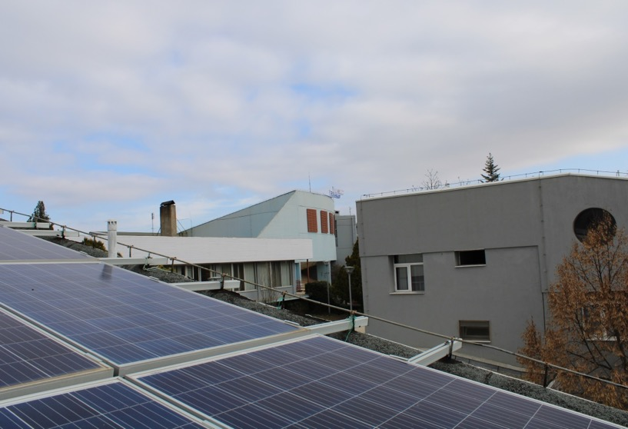
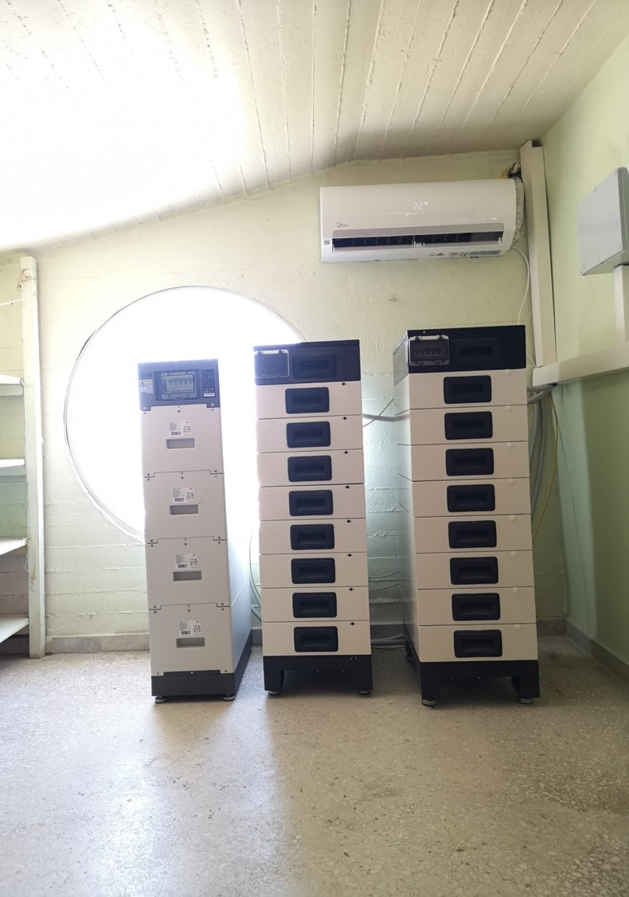
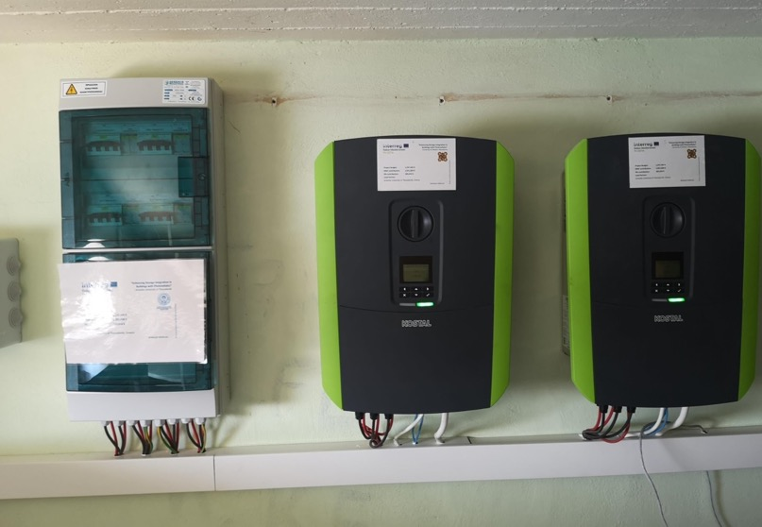
Photovoltaics and battery systems
35.4 kWp of PV
31.4 kWh of battery systems (Li-Ion)
Divided in three subsystems
Using three hybrid inverters

Slide 6
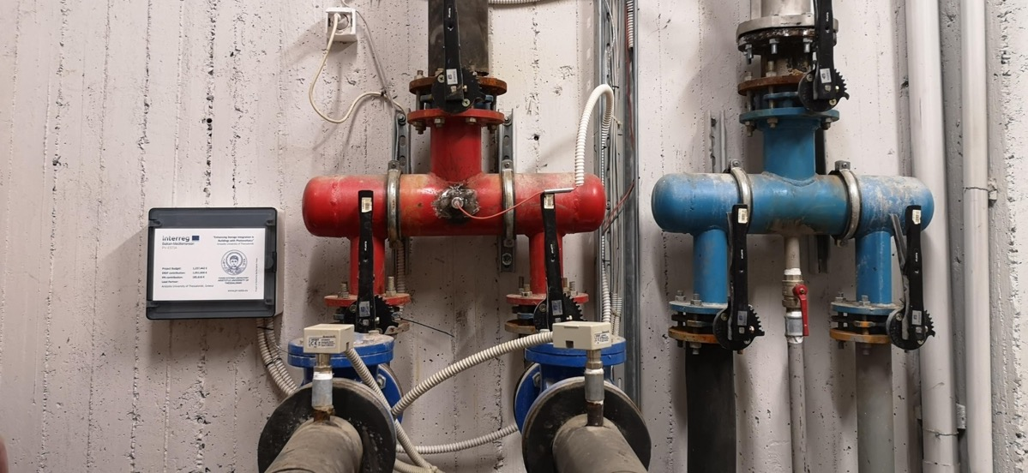
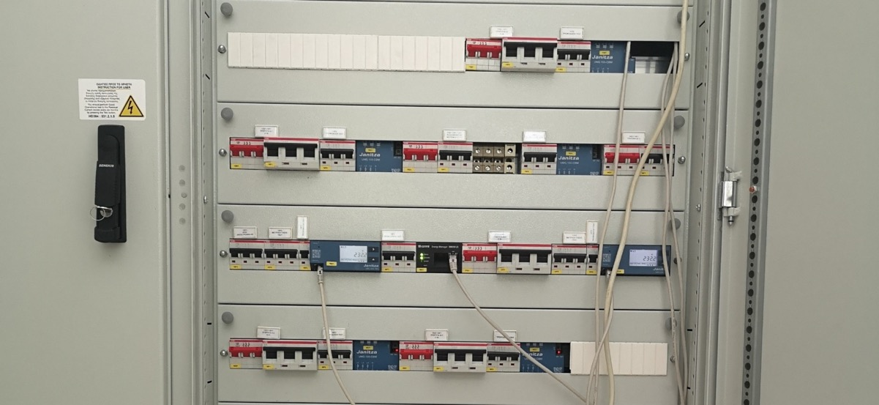
Energy meters
Power quality analyzers monitoring multiple points of the installation (including up to 50th harmonic)
Thermal energy meter

Slide 7
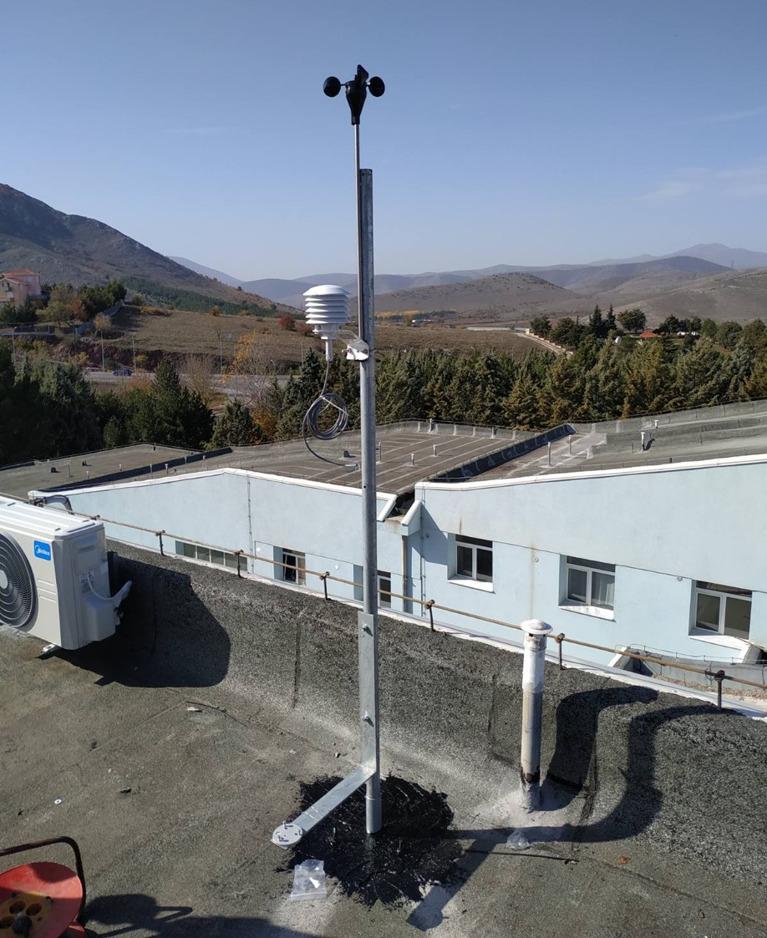
Weather station and other meters
Meteorological station
Thermometers and humidity meters
At corridors
At certain rooms

Slide 8
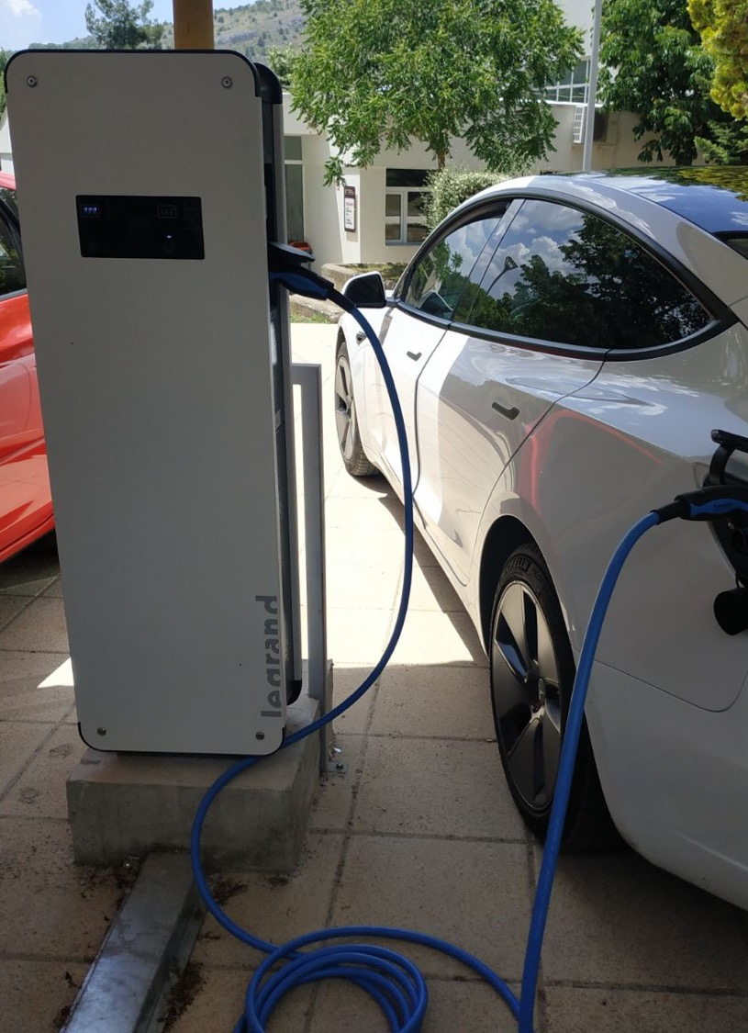
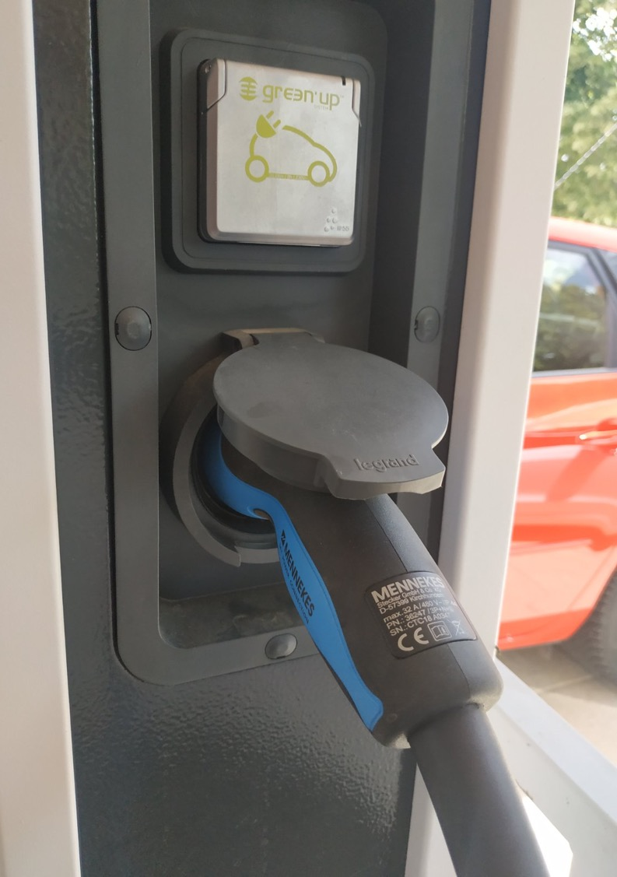
Car charger
22 kW AC charger
Capable of 2 simultaneous charging processes

Slide 9
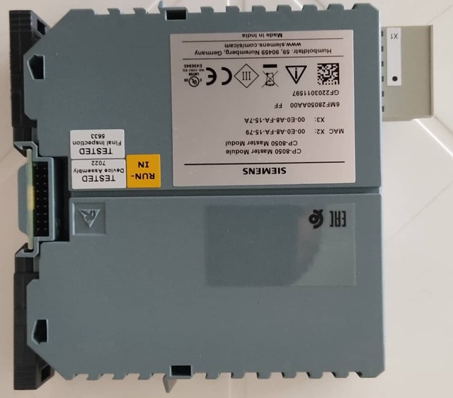
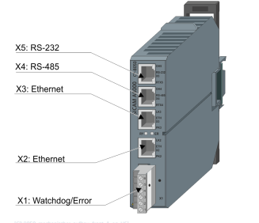
Energy management system
Siemens controller for regulating
car charger
battery
shiftable loads
3 electronically programmable loads (by Chroma)

Slide 10
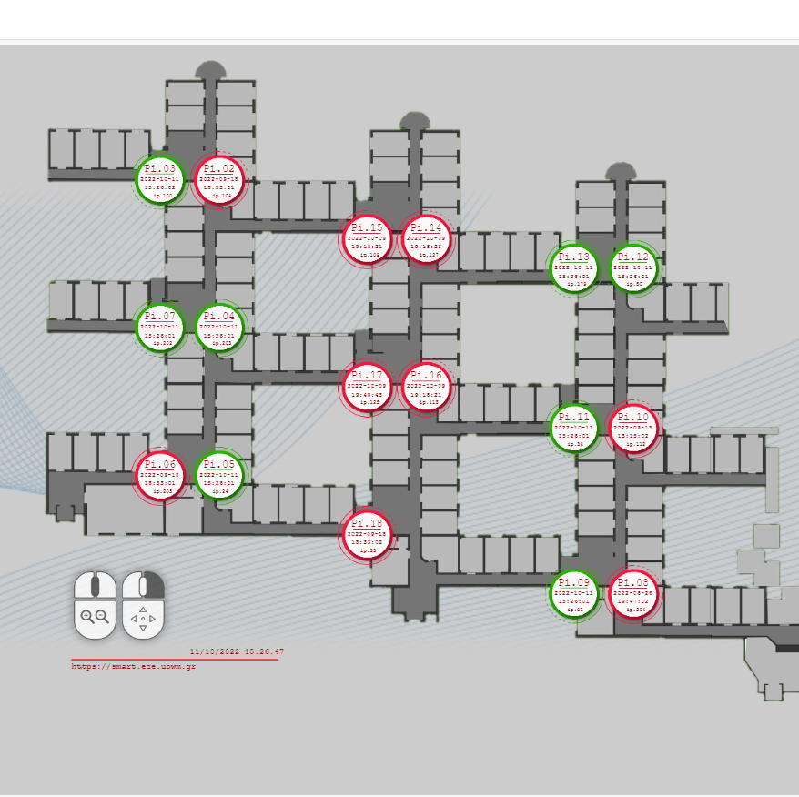
Extra features
Smart plugs at certain rooms for
switch control capability
energy monitoring
Corridor lighting switchboard ready for the control through remote switch capability

Slide 11
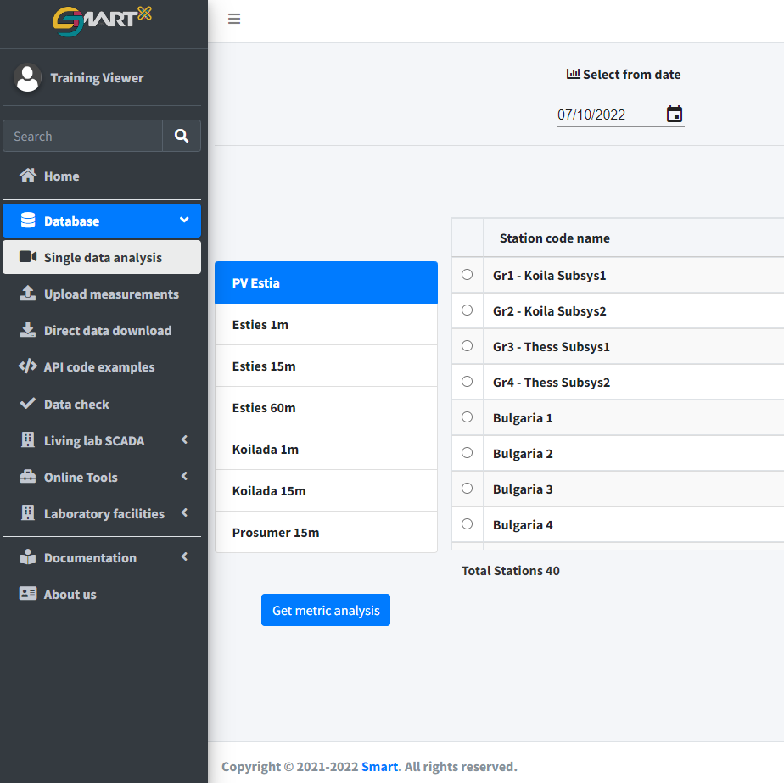
Measurements database
For the collection of all measurement data
For downloading requested datasets
For visualization of measurements
For monitoring the integrity of collected measurements
With e-mail notification with the status of collection system
With e-mail notification in case of measurement device disconnection

Slide 12
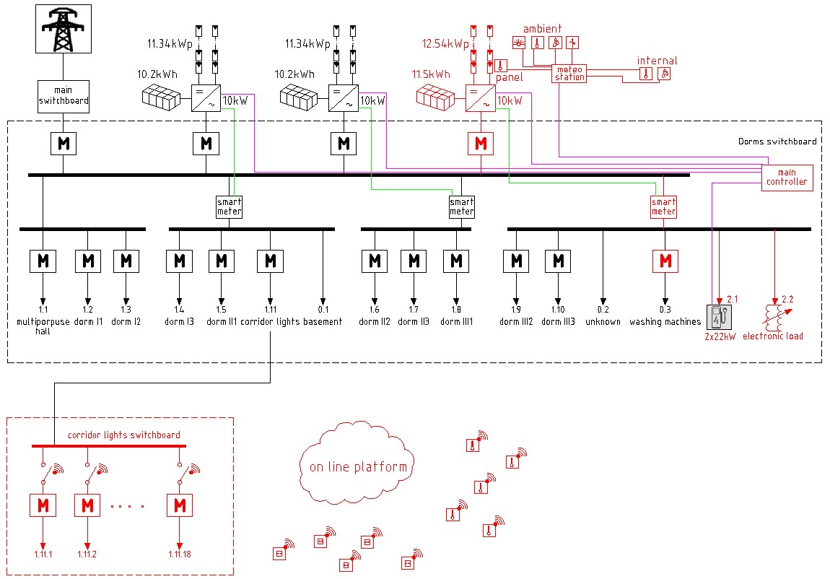
Electrical diagram

Slide 13
Research Activities
PV and load forecasting models
Non-Intrusive Load Monitoring (NILM) algorithms
Open Access database
EV optimal charging schemes

